Slide 1


Social Buzz Analysis

Slide 2


Today's agenda
Project recap
Problem
The Analytics team
Process
Insights
Summary

Slide 3

S
Social Buzz is the Fastest-growing technology
Unicorn that requires speedy worldwide
adaptation .
Accenture has started three-month POC
with these task as core.
1) An audit of their big data practice.
2) Recommendations for a successful IPO.
3) An analysis to find Social Buzz’s top 5
most popularity categories of content.
Project Recap

Slide 4

h
Problem
As an Analyst
I Want to find Social Buzz’s top 5 most popular categories of content
So that Social Buzz’s can use that insight to capitalize its organization

Slide 5



Andrew Fleming
Chief Technical Architect
The Analytics team
Marcus Rompton
Senior Principle
Akash Gupta
Data Analyst

Slide 6
Process
1
Required Data Gathering
2
Data Cleaning
3
Data modeling
4
Data Analysis
5
Getting Insights from Data

Slide 7

Insights
categories
Reactions to “Animal” Post
Month with most Post
16
1897
January

Slide 8
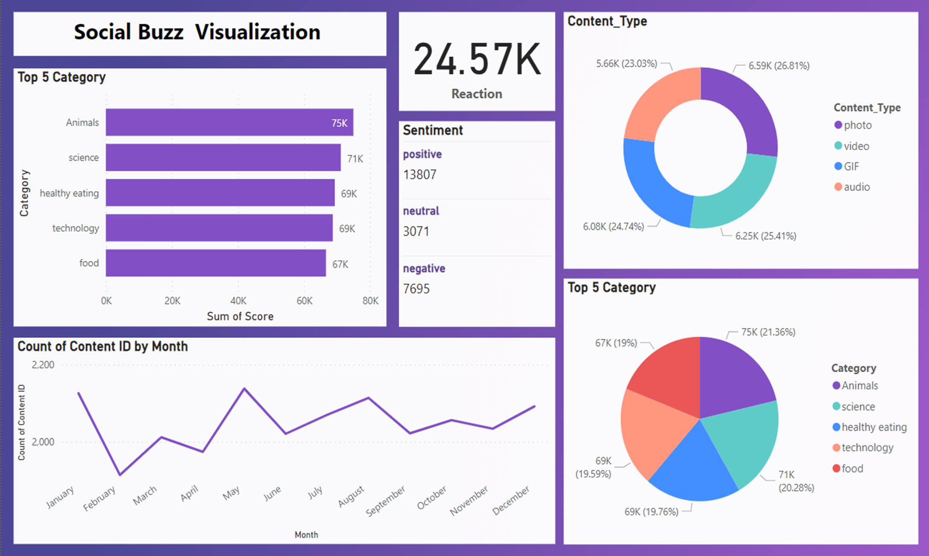

Slide 9
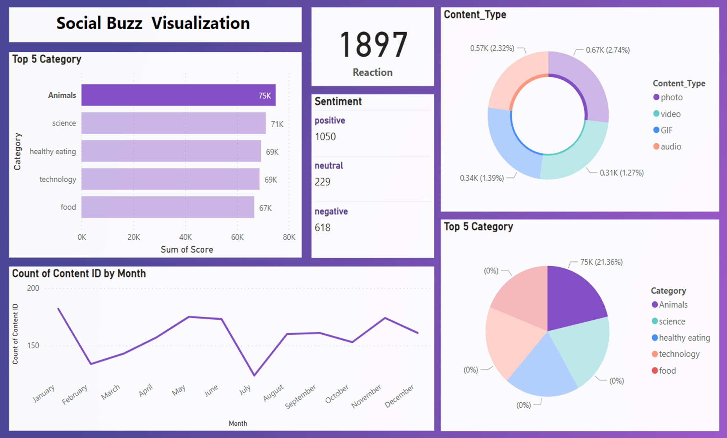

Slide 10

ANALYSIS –
Many People love two categories of content which are animal and Science in which major content types are Photos for animals and Videos for Science.
INSIGHT –
Food is rated the most time in which, “Health Eating ” is ranked highest.
This indicates that the user base is interested in healthy food, so you can engage with healthy eating brands and create campaigns accordingly to increase user engagement.
NEXT STEP –
Taking our analysis to a large scale, now it's time for a real-time understanding of your business, we can show you how to do this.
Summary

Slide 11
Thank you!
ANY QUESTIONS?

